Slide 1
Digital Image Processing 3
Dep. of Computer Science & Information Engineering, Asia University
Associate Professor
Rung-Shen Chen

Slide 2
1. Continuing of Pillow
2. Introduction of scikit-image
3. Color model

Slide 3
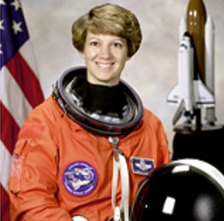
1.Continuing of Pillow Accessing pixels of an image
img = Image.open("F:/Computer Vision/newastronaut.png")
print (img.size)
(512, 512)
img.getpixel((355,443))
(254, 254, 254)
1. Sometimes for performing tasks we have to access the individual pixels in an image. Pillow provides a
PixelAccess class with functions to manipulate image pixel values.
2. getpixel() and
putpixel() are some of the functions in the PixelAccess class
(254, 254, 254)

Slide 4
getpixel(): This function returns the color value of the pixel at the (x, y)
coordinate. It takes a tuple as an argument and returns a tuple of color values:
img.getpixel((355,443))
(254, 254, 254)

Slide 5
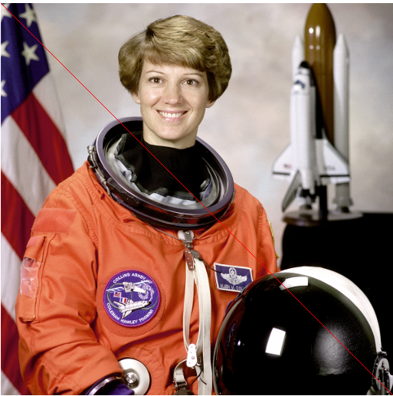
putpixel(): This function changes the color value of the pixel at the (x, y)
coordinate to a new color value.
from PIL import Image
img = Image.open("newastronaut.png")
width, height = img.size
for x in range(height):
img.putpixel( (x, x), (255, 0, 0) )
img.show()

Slide 6
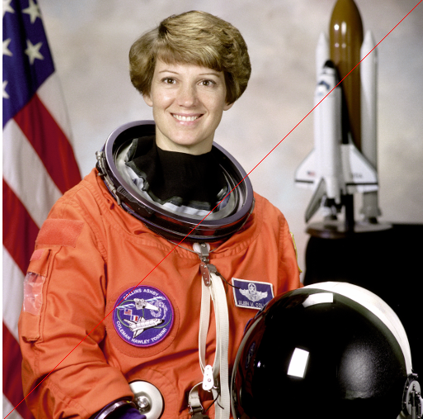
from PIL import Image
img = Image.open("newastronaut.png")
width, height = img.size
for x in range(width):
img.putpixel( (511-x, x), (255, 0, 0) )
img.show()

Slide 7
2. Introduction of scikit-image
In this section, we will learn about another Python library for image processing, scikit-image, also represented as skimage.
Ref:
http://scikit-image.org/

Slide 8
2-1 Installation
conda install -c conda-forge scikit-image
or
python –m pip install scikit-image
Check skimage version at anacoda prompt
python -c "import skimage; print(skimage.__version__)«
P.S: If you install Anaconda3-2020.11-Windows-x86_64, then the scikit-image is already saved.

Slide 9
2-2 Io module
Reading an image:
As you know, reading an image is the most fundamental operation you would like to perform.
In scikit-image, the image can be read using the imread() function in the io module of the library. It returns an ndarray.
An ndarray in Python is an N dimensional array. The following is an example:

Slide 10
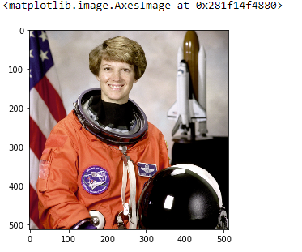
[]from skimage import io # import io from skimage
[]img = io.imread("newastronaut.png") # apply imread() function
[] io.imshow(img) # apply imshow function
[] type(img)
numpy.ndarray # An ndarray in Python is an N dimensional array.

Slide 11
[] import matplotlib.pyplot as plt
[] plt.imshow(img) # option for display image

Slide 12
2-3 Data module
This module provides some standard test images which one can work on like a grayscale camera image, grayscale text image, coffee cup, and so on. These images can be used as great examples to demonstrate some of the algorithms in image processing.

Slide 13
[] from skimage import data
[]img=data.astronaut()
[]io.imshow(img)
[]print(img.shape)
(512, 512)
[]io.imsave('0309astronaut.png', img) #To save or write an image we can use the imsave() function.
Ref: https://scikit-image.org/docs/0.13.x/api/skimage.data.html

Slide 14
2-4 color module
This module of the library contains functions for converting the image from one color space to another.
Ref:
https://scikit-image.org/docs/dev/api/skimage.color.html?highlight=label2rgb

Slide 15
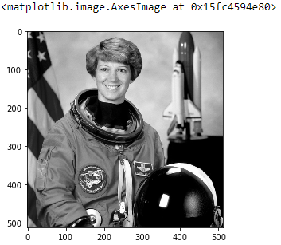
2-4-1 Convert RGB to gray:
The rgb2gray() function in the module can be used to convert a RGB image to a grayscale image. It takes the RGB image array as input and returns the grayscale image array.
[] from skimage import io, color
[]img=io.imread('newastronaut.png')
[] gray = color.rgb2gray(img)
[] io.imshow(gray)

Slide 16
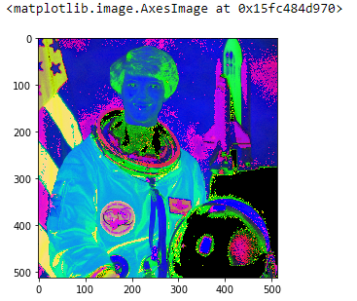
[] from skimage import io, color
[]img=io.imread('newastronaut.png')
[] img_hsv = color.rgb2hsv(img)
[] io.imshow(img_hsv)
204-2 Convert RGB to HSV:
The rgb2hsv() function in the module can be used to
convert an RGB image to an HSV image. It takes the RGB image array as input and returns the HSV image array.

Slide 17
3.Color model
Most color models in use today are oriented either toward hardware (such as for color monitors and printers) or toward applications, where color manipulation is a goal (the creation of color graphics for animation is an example of the latter).
In terms of digital image processing,
①the hardware-oriented models most commonly used in practice are the RGB (red, green, blue) model for color monitors and a broad class of color video cameras;
②and the HSI or HSV(hue, saturation, intensity or value) model, which corresponds closely with the way humans describe and interpret color.

Slide 18
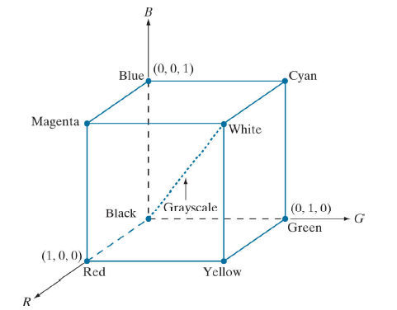
3-1 The RGB Color Model
In the RGB model, each color appears in its primary spectral components of red, green, and blue.
This model is based on a Cartesian
coordinate system. The color subspace of interest is the cube shown in Fig. 3-1 , in which RGB primary values are at three corners; the secondary colors cyan, magenta, and yellow are at three other corners; black is at the origin; and white is at the corner farthest from the origin.
Fig. 3-1
Schematic of the RGB color cube. Points along the main diagonal have gray values, from black at the origin to white at point (1, 1, 1)(normalized scale).

Slide 19
The number of bits used to represent each pixel in RGB space is called the pixel depth. Consider an RGB image in which each of the red, green, and blue images is an 8-bit image. Under these conditions, each RGB color pixel [that is, a triplet of values (R, G, B)] has a depth of 24 bits (3 image planes times the number of bits per plane).
The term full-color image is used often to denote a 24-bit RGB color image.
The total number of possible colors in a 24-bit RGB image is (2^8)^3 = 16, 777, 216.

Slide 20
3-2 The HSI Color Model
When humans view a color object, we describe it by its hue, saturation, and brightness.
Recall from the discussion in 3-1 that hue is a color attribute that describes a pure color (pure yellow, orange, or red), whereas saturation gives a measure of the degree to which a pure color is diluted by white light. Brightness is a subjective descriptor that is practically impossible to measure. It embodies
the achromatic notion of intensity and is one of the key factors in describing color sensation.

Slide 21
An RGB color image is composed three gray-scale intensity images (representing red, green, and
blue), so it should come as no surprise that we can to extract intensity from an RGB image.

Slide 22
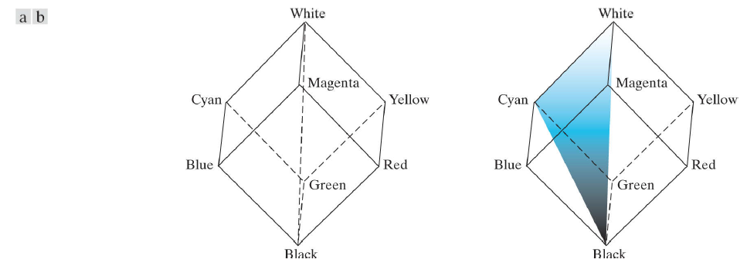
This becomes clear if we take the color cube from Fig. 3-1 and stand it on the black, (0, 0, 0), vertex, with the white, (1, 1, 1), vertex directly above it [see Fig. 3-2 (a)].
In Figs. 3-2 (a) and
(b), the line (intensity axis) joining the black and white vertices is vertical.
Thus, if we wanted to determine the “intensity” component of any color point in Fig. 3-2, we would simply pass a plane perpendicular to the intensity axis and containing the color point.
Fig. 3-1
Fig. 3-2 Conceptual relationships between the RGB and HSI color models

Slide 23
We also note that the saturation (purity) （S of HIS ） of a color increases as a function of distance from the intensity axis.(The more far away from the intensity axis, the more saturation it has. If the color point is close to the intensity axis, it turns out to only get gray level)
Fig. 3-1
Fig. 3-2 Conceptual relationships between the RGB and HSI color models

Slide 24
Hue can be determined from an RGB value also. To see how, consider Fig. 3-2(b) , which shows a plane defined by three points(black, white, and cyan). The fact that the black and white points are contained in the plane tells us that the intensity axis also is contained in the plane. Furthermore, we see that all points contained in the plane segment defined by the intensity axis and the
boundaries of the cube have the same hue (cyan in this case).
Fig. 3-1
Fig. 3-2 Conceptual relationships between the RGB and HSI color models

Slide 25
Ref:
Rafael C. Gonzalez, Richard E. Woods, “Digital Image Procession”, Second Edition, International Edition, 2002

